Slide 1

Analysis of AMCAT Data

Slide 2
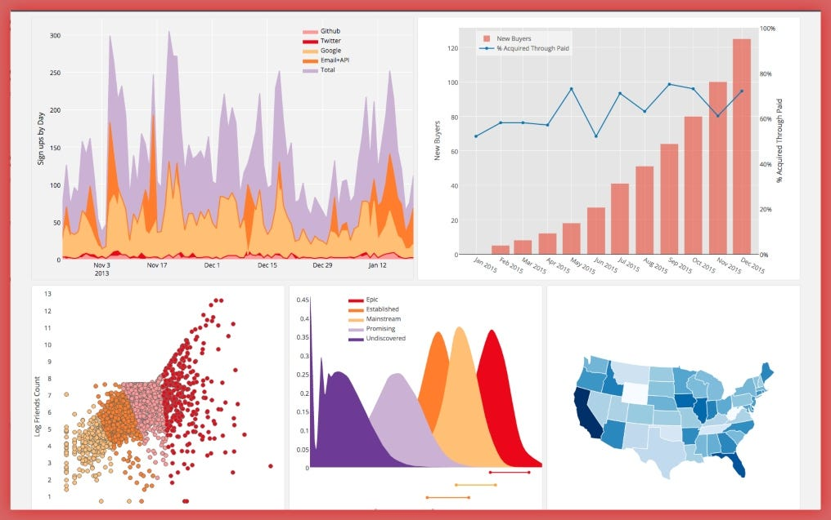
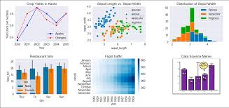
About me
Name: Rohit Sahu Qualification: M.Sc. Electronics
Any Work Experience: Fresher
LinkedIn Profile: https://www.linkedin.com/in/rohit-sahu1998/
Github:

Slide 3
Problem Statement
Segmenting job applicants into different categories based on their qualifications, experience, and test scores.
Creating profiles of successful candidates for different job roles or in
Determining which factors have the most influence on job performance or other desired outcomes.
Visualizing the distribution of scores, qualifications, and other attributes within the dataset.
Exploring correlations and relationships between different variables to gain insights into the factors affecting job success.

Slide 4
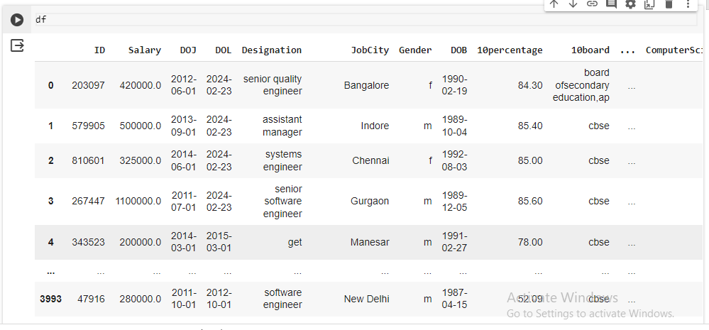
Uncleaned Data

Slide 5
Steps For Cleaning Data
Renaming Column Names
Dropping Unnecessary Columns
Checking for removal of Duplicates
Checking the data types of each column
Check for Null values
Filling the Null Values

Slide 6
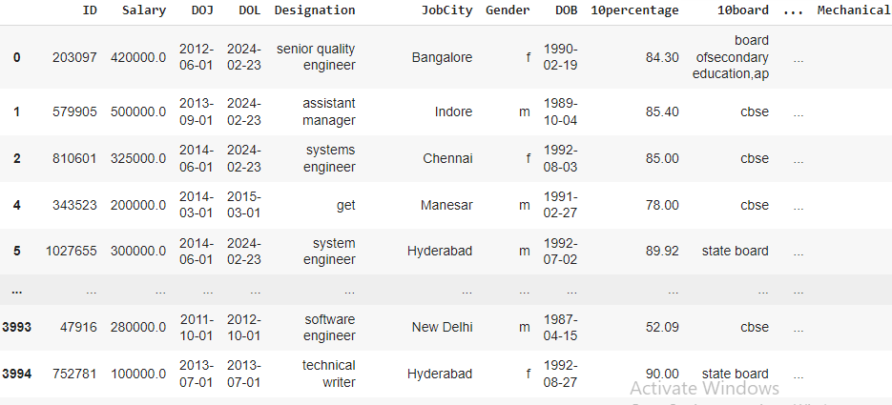
Cleaned Data

Slide 7
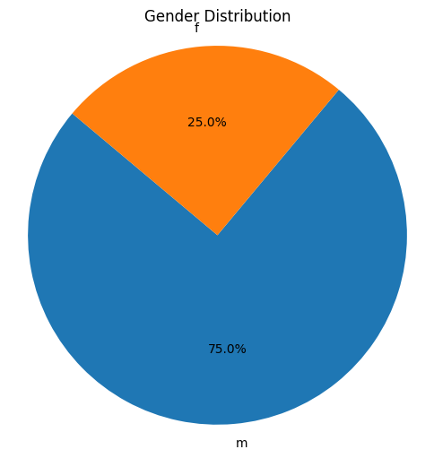
Univariate Analysis
From the Given Pie chart we can say that the frequency of Male is greater than Female frequency

Slide 8
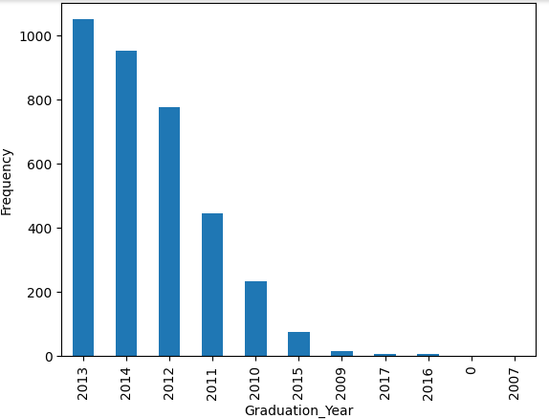
From the given bar plot we can say that there are more people who are from 2013 year

Slide 9
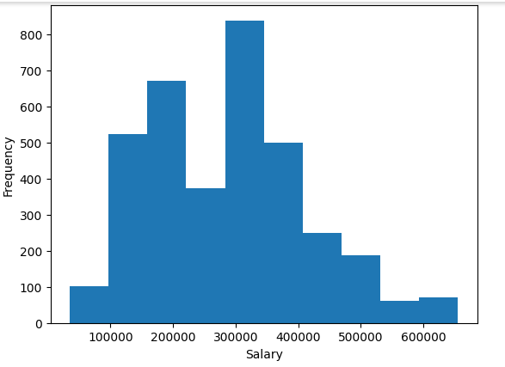
The frequency of Salary is more between 300000 to 400000

Slide 10
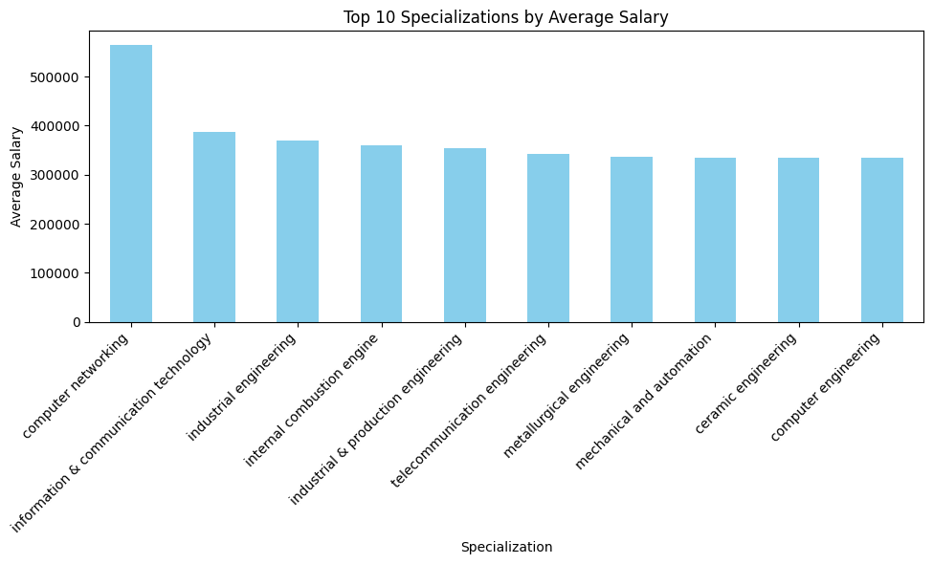
Bivariate Analysis
The Max salary is given to Computer networking specialization

Slide 11
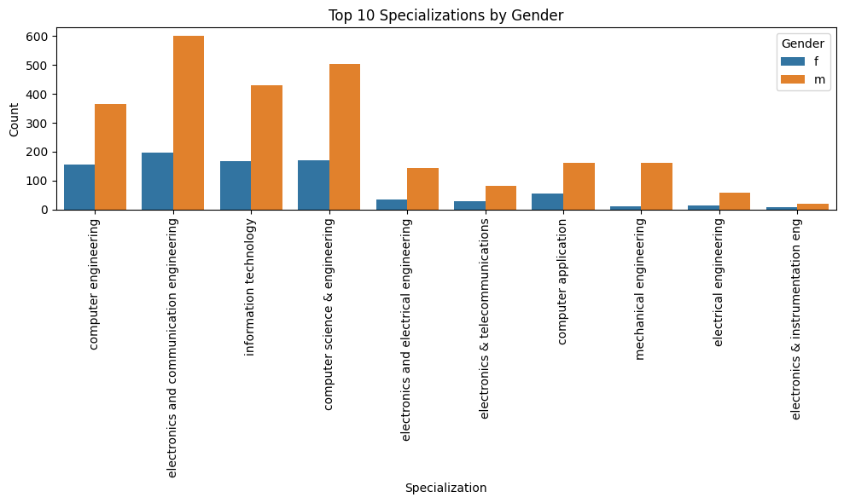
There are max electronics and communication engineering people in the whole data

Slide 12
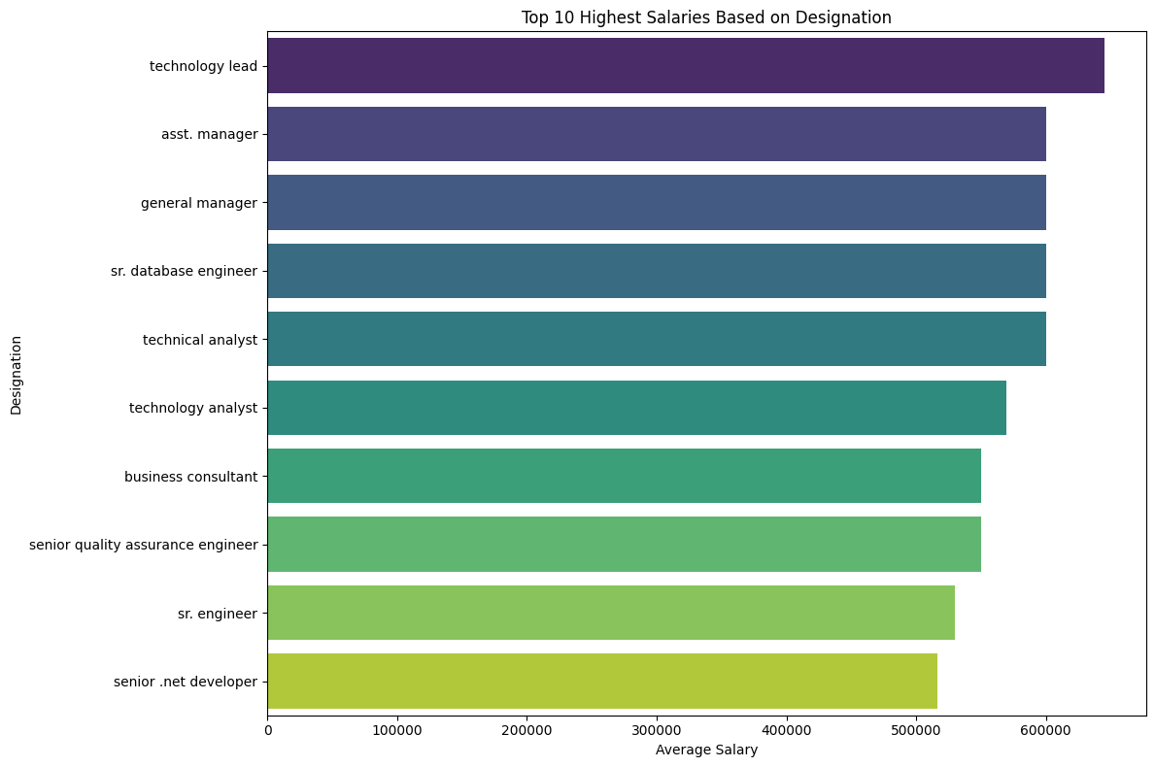
Based on Designation Technology lead is getting the highest salary

Slide 13

THANK YOU

